Slide 1

Barcode Roulette

Slide 2
What’s the Deal?

Slide 3
Big Insights
2
Consumer Stickiness
Instant Gratification
Notes:
Big Insights (2)

Slide 4
34
surveys
3+
Interviews
“I need to increase return incidences!”
“I want a deal now!”
Notes:
Most people will never acquire enough points to pay for the luxury items they desire. And many reward programs are deliberately deceptive in describing how they work. Not all points are created equal and some are downright worthless

Slide 5
1
Big Idea
Notes:
The Big Idea

Slide 6
Chance your Awards
Notes:
The Big Reveal (LOGO)

Slide 7
Show me the MONEY!
Monthly cost
Low risk
High risk
Number of customers
Notes:
The business Model (How do we make money)

Slide 8
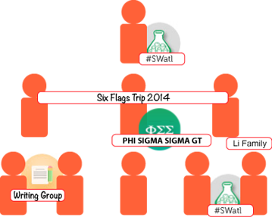
Show me the USERS!
Notes:
The business Model (How do we make money)

Slide 9


















Imagine...
Notes:
Future Revenue Growth areas

